Slide 1



From Data to Decisions
A Journey Through the Supply Chain
AST-DAT-GIE
DEPI Graduation Project

Slide 2




Why Supply Chain Analysis?
We chose supply chain analysis because it is a crucial component for organizations aiming to optimize operations. As supply chains grow more complex in global markets, accurate analysis becomes essential for improving efficiency, reducing costs, and managing risks. this project , this one offers a unique opportunity to explore how data can enhance customer experience and support data-driven decision-making.

Slide 3

Analysis & Prediction Questions
1-What is the total sales amount generated?
2-How much total discount has been applied?
3-What is the total profit earned?
4-What is the average sales value per order?
5-Which payment methods are mostcommonly used for sales?
6-Which customer segments contribute the most to sales?
7-Which customer segment generates the highest order profit?
8-Which countries have the highest profit per order?
9-Which product categories are generating the most sales?

Slide 4

Analysis & Prediction Questions
10-Which products are the most profitable based on order profit?
11-Which cities have the highest number of customer orders?
12-What is the distribution of order statuses ?
13-Which countries have the highest number of suspected fraudulent orders?
14-Which countries have the highest customer orders?
15-Which states have the most customer orders?
16-Which customers are suspected of fraudulent activities
the most?

Slide 5

Analysis & Prediction Questions
17-What are the different segments for delivery status ?
18-What shipping modes are most frequently used for orders
19-How do sales vary based on late delivery risk
20- Which shipping modes are the most profitable?

Slide 6
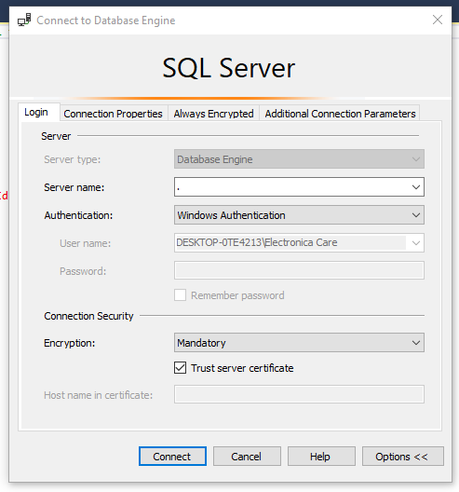
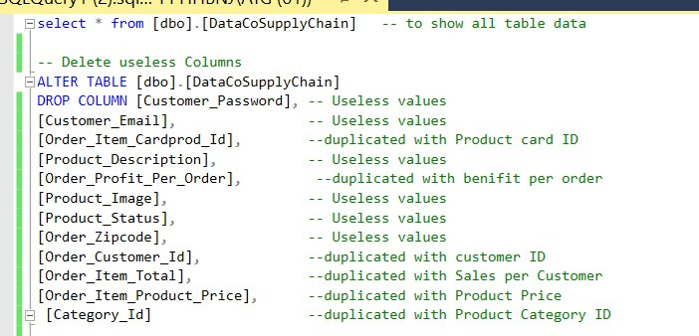
Explore & clean data by SQL

Slide 7
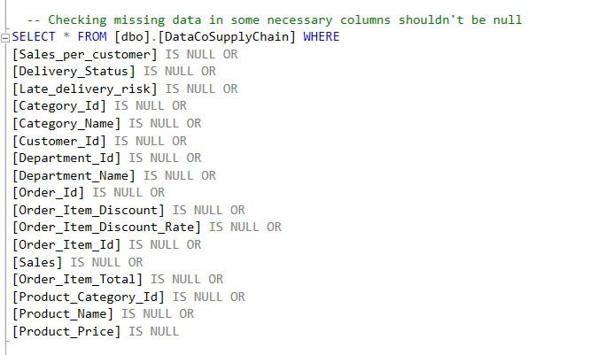
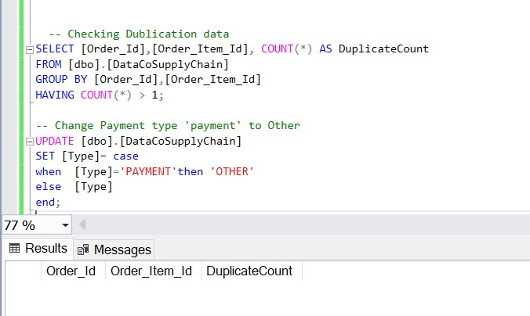
Explore & clean data by SQL

Slide 8
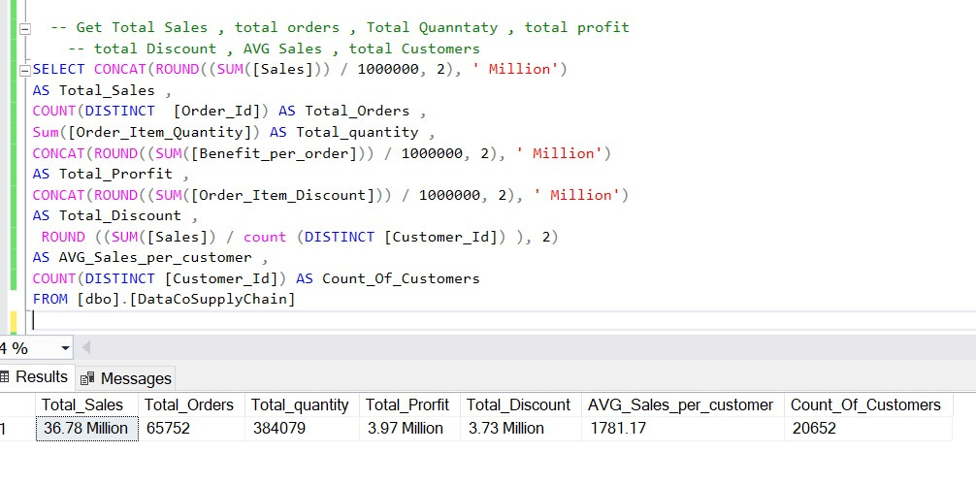
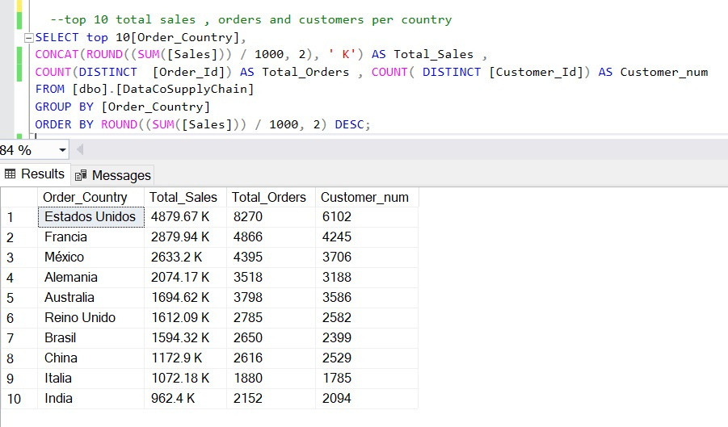
Analyze Data by SQL

Slide 9
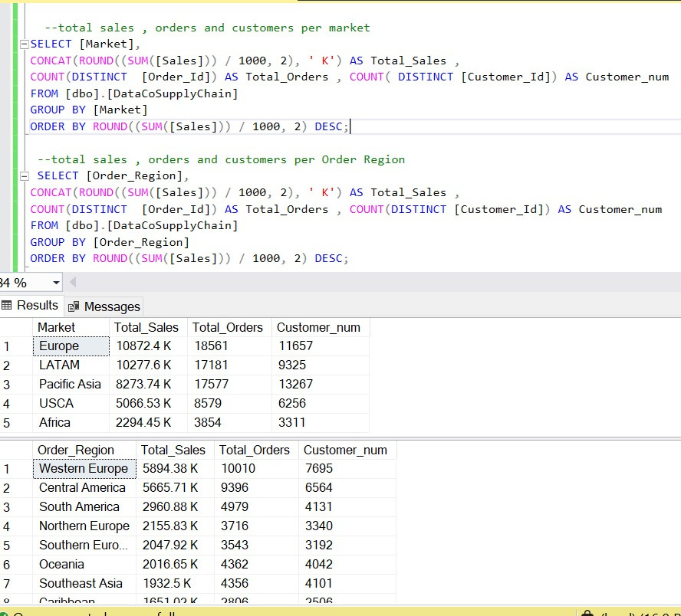
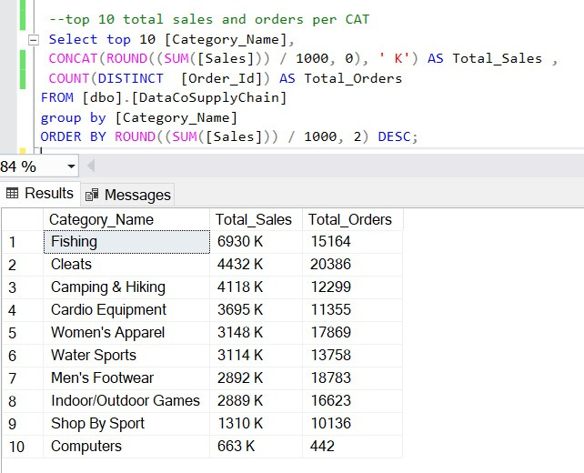
Analyze Data by SQL

Slide 10
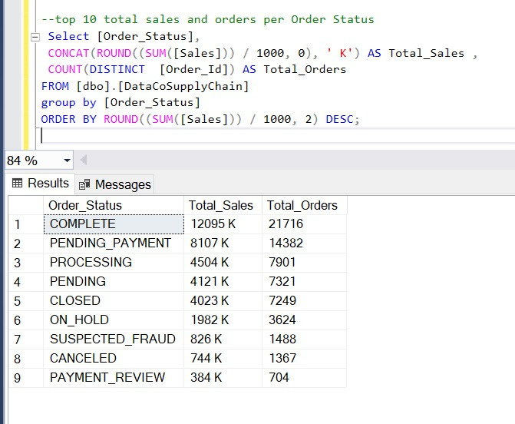
Analyze Data by SQL

Slide 11
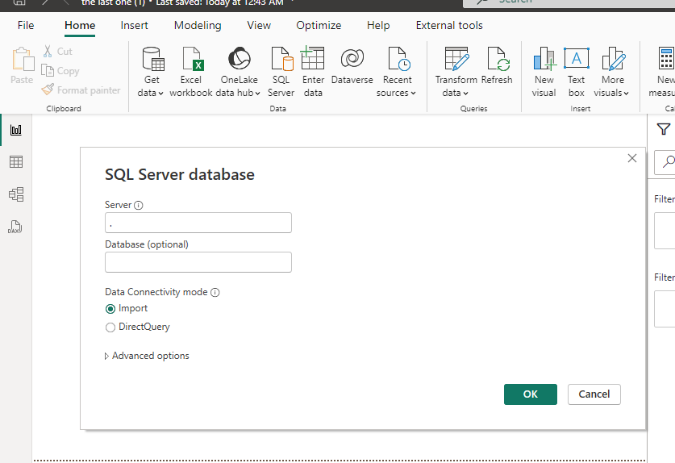
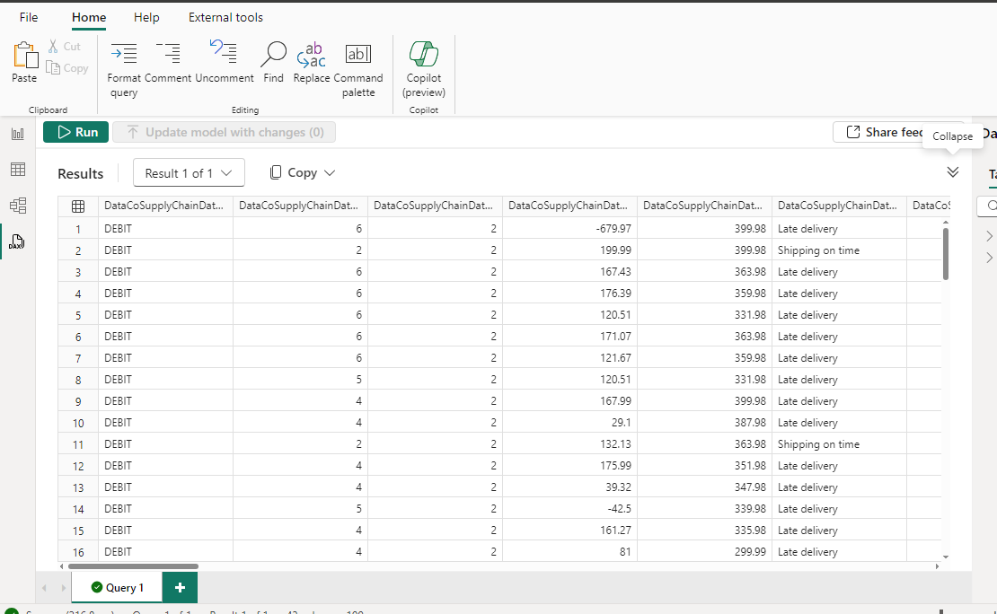
Analyze Data by Power BI

Slide 12
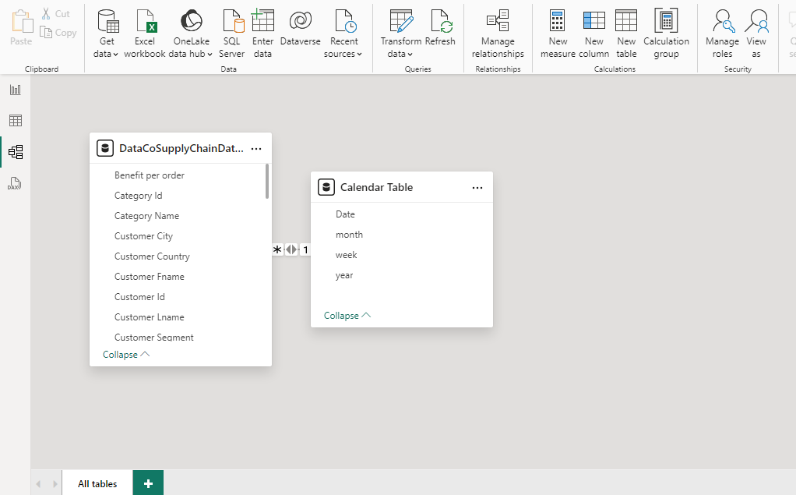
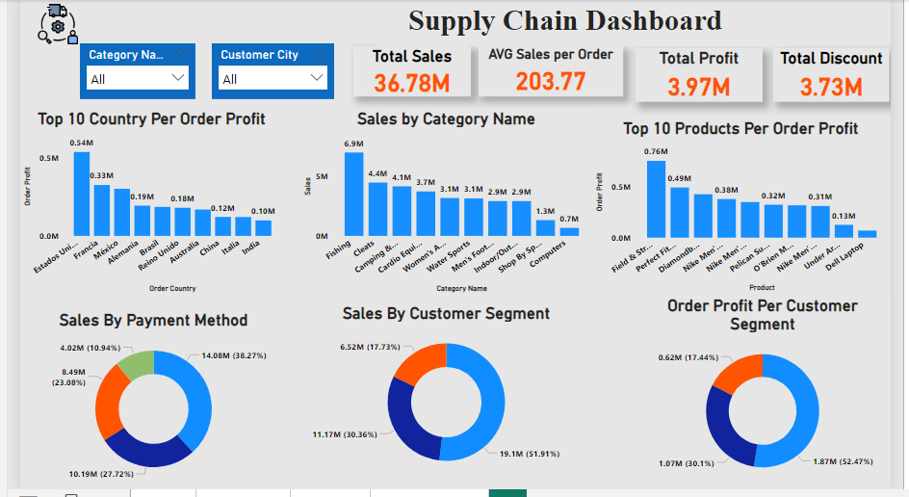
Analyze Data by Power BI

Slide 13
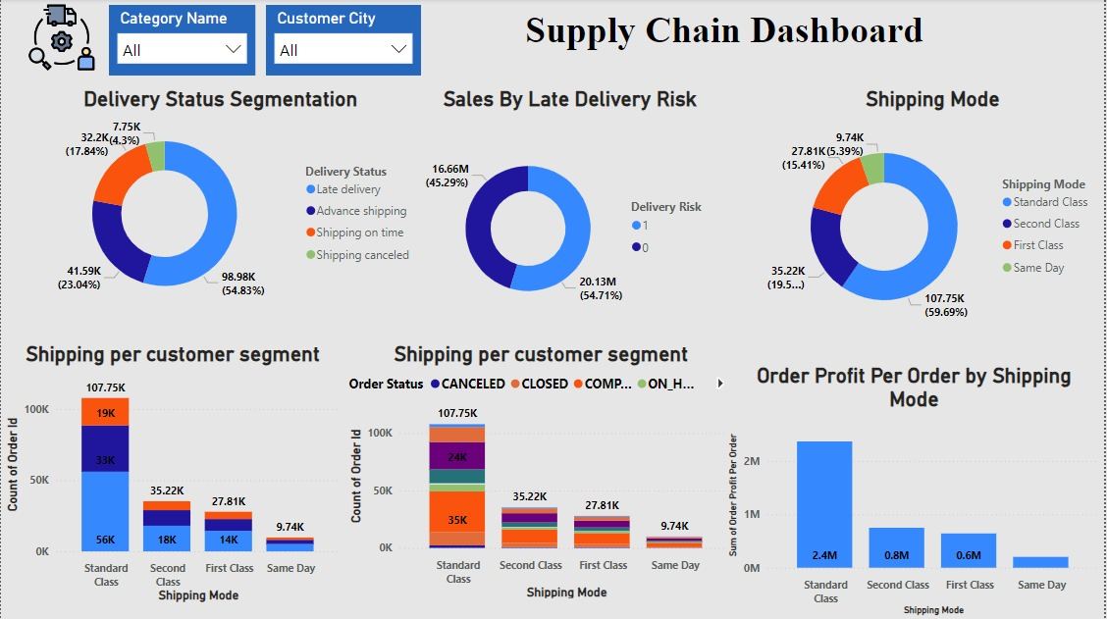
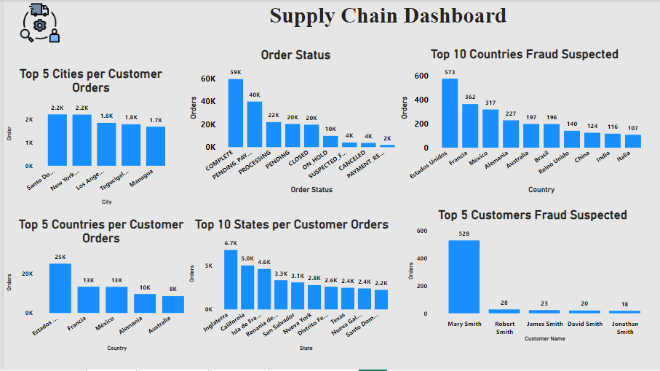
Analyze Data by Power BI

Slide 14
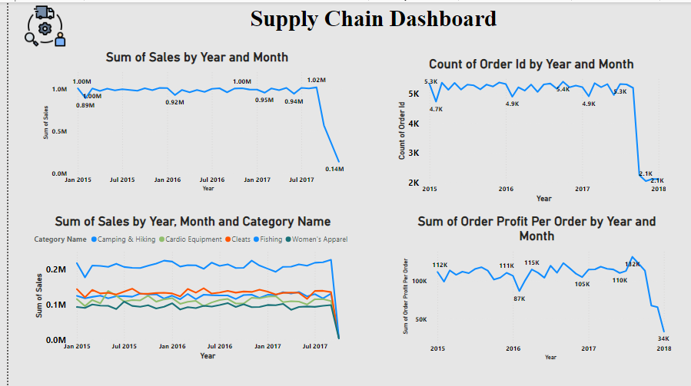
Analyze Data by Power BI

Slide 15

Strategic Recommendations
1-Enhance Bank Transfer Payment Option
2-Optimize Standard Shipping
3-Focus on the Consumer Segment
4-Reduce Delivery Delay Risk
5-Expand Fraud Prevention Strategies
6- Improve Shipping Performance by Mode

Slide 16
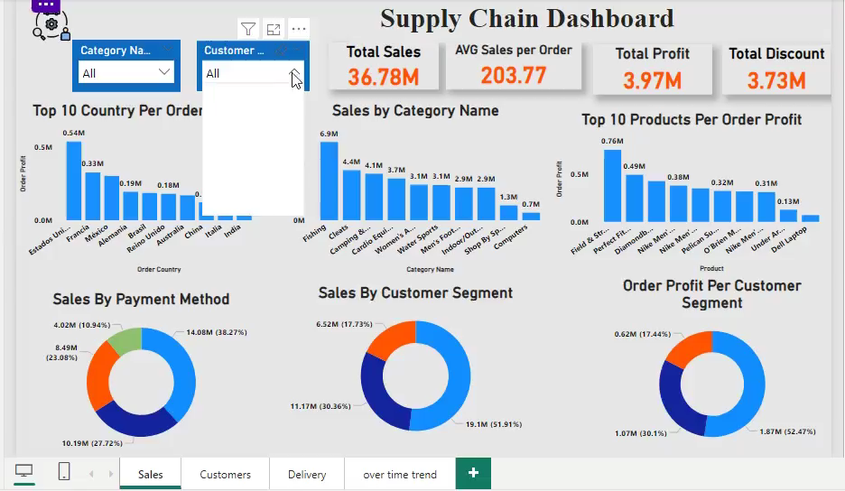
Related Video

Slide 17
Our Team
Khaled Waled
Mohamed Abdelaal
Taha Atef
Mohamed Ragheb
Asmaa Ahmed

Slide 18
Thank You
Data Analysis AST-DAT-GIE
DEPI Graduation Project
Under Supervision Eng. Mohamed Ahmed

